Slide 1
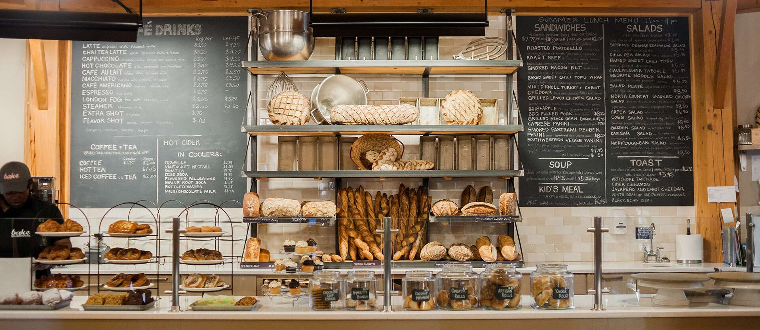
Slide 1
BAKERY STORE IN SANTO DOMINGO
Junior Peña

Slide 2
Slide 1
INTRODUCTION

Slide 3

Slide 2
Background
In the Dominican Republic people don’t tend to follow certain rules when opening a new business. The first and principal motivator is “I need to open my business wherever I want because I know the product, I have is going to attract people”. This thinking works for some for a few months, but it does not for the majority. Usually, we don’t think the location as a relevant factor when taking this important step, but is one of the first things we need to figure it out. It’s true that the brands attract people, but this is when you have a product well established and known. In most cases you need to go where people will see you regardless if they are looking for the thing you sell. Therefore, it is necessary to be sure where exactly is the best location in order to maximize the customer flow and the business profits.

Slide 4
Slide 2
¿What is the problem?
Josh is a recent college graduate who is looking for places in Santo Domingo, Dominican Republic to open a new bakery store. He already has the employees and resources necessary to open the business, but he needs to determine where exactly is the best place (neighborhood) to open it.
In Santo Domingo, there are many bakery stores in every neighborhood, so it is necessary to choose the best place in order to maximize customer flow and profits. He knows the competition is rough, but also there are many bakery stores who open and stay in business successfully. Nevertheless, others don’t have the same fate and close in just months. Josh needs to be presented a model to determine where is the best place where he can find success.

Slide 5
Slide 1
DATA ACQUISITION AND CLEANING

Slide 6
Slide 3
Data sources
In this scenario the data we are going to use is:
A csv file with a list of all the neighborhoods in Santo Domingo. This file contains three columns: the postal code for each neighborhood, borough and the neighborhood name. This is going to be helpful because it's the base file which we are going to use to create the dataset and the model.
A csv file with the coordinates of each neighborhood. This file contains three columns: the postal code for each neighborhood, the latitude of each neighborhood and the longitude of each neighborhood. This is necessary because it contains the exact location of each neighborhood which is essential to determine where is the best place to open the bakery.
The Foursquare location data to create the model based on the coordinates. This will help us to obtain the venues in each location.

Slide 7
Slide 3
Data Cleaning
There were multiple problems with the data files which we needed to fix before starting to implement the model:
First, the coordinates data was arranged in multiple pages, so we merged all the 546 rows in one single sheet. This was performed manually because the web page does not have a way to download a document with this information.
Second, as the data is in Spanish, there were some special characters used not recognized in the English language which had to be manually removed.
Third, we used the list of all neighborhoods and group them by Postal code and Borough in the notebook. This was done because there were some neighborhoods with the same postal code, so we joined them together. After this, we exported the csv file and added the coordinates of each neighborhoods with a VLOOKUP function in Excel.
All the columns were checked to see if missing values were present. As we are dealing with a dataset with few columns, none of them had missing values. Finally, after all the changes and grouping, we had a dataset consisting in 4 Boroughs and 207 neighborhoods.

Slide 8
Slide 3
Feature Selection
Kept features | Dropped features | Reason for dropping
Postal Code | N/A | Data without conflict or null values
Borough | N/A | Data without conflict or null values
Neighborhood | N/A | Data without conflict or null values
Latitude | N/A | Data without conflict or null values
Longitude | N/A | Data without conflict or null values

Slide 9
Slide 1
EXPLORATORY DATA ANALYSIS

Slide 10
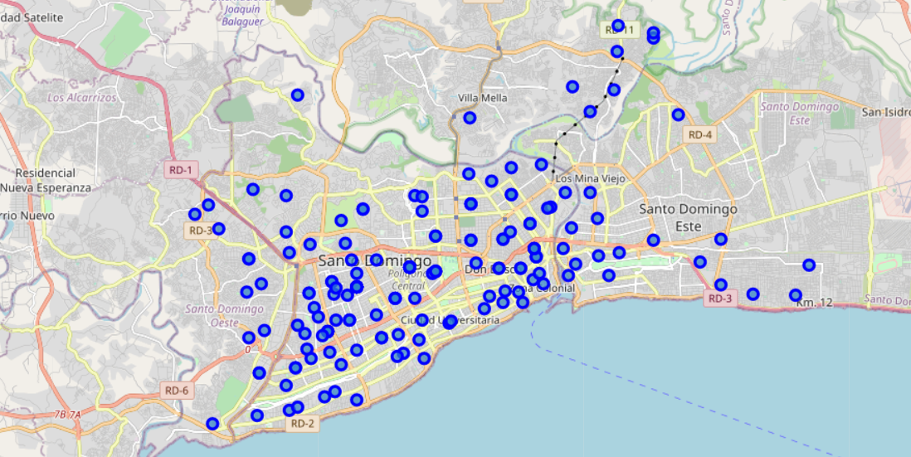
Slide 3
Cluster the neighborhoods in Santo Domingo
After grouping the variable specified in the data cleaning part, we had a dataset with five columns as shown below. Keep in mind that the neighborhoods are merged by postal code and Borough. Using the geopy library we get the latitude and longitude of Santo Domingo to be able to show the map of the whole city and mark each neighborhood inside it. In order to define an instance of the geocoder, we need to define a user_agent.

Slide 11
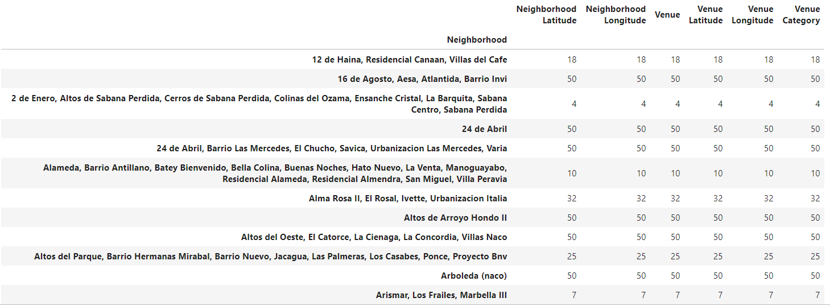
Slide 3
Cluster the neighborhoods in Santo Domingo
We define a function to obtain the categories and name of the venues and then we structure the information into a panda’s data frame. We can group the information by neighborhood to visualize how many venues are in each one of them.

Slide 12
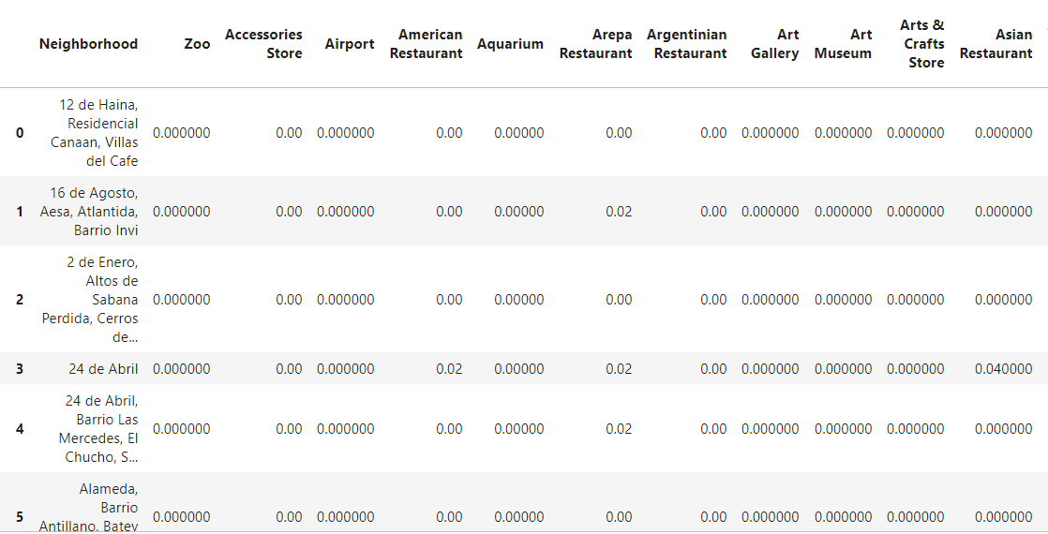
Slide 3
Analyze each Neighborhood
Using one hot encoding, we can create a new data frame to have each venue category as a column and then group the rows by neighborhood and by taking the mean of the frequency of occurrence of each category.

Slide 13
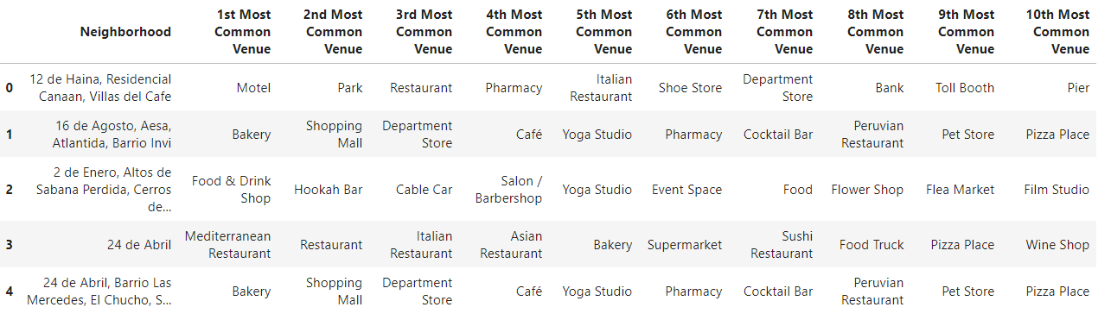
Slide 3
Analyze each Neighborhood
We can create a 'For Loop' to print each neighborhood along with the top 5 most common venues. Next, we define a new function and a loop to save these new values in a data frame with the ten top venues per neighborhood.

Slide 14
Slide 1
CLASSIFICATION MODELING

Slide 15
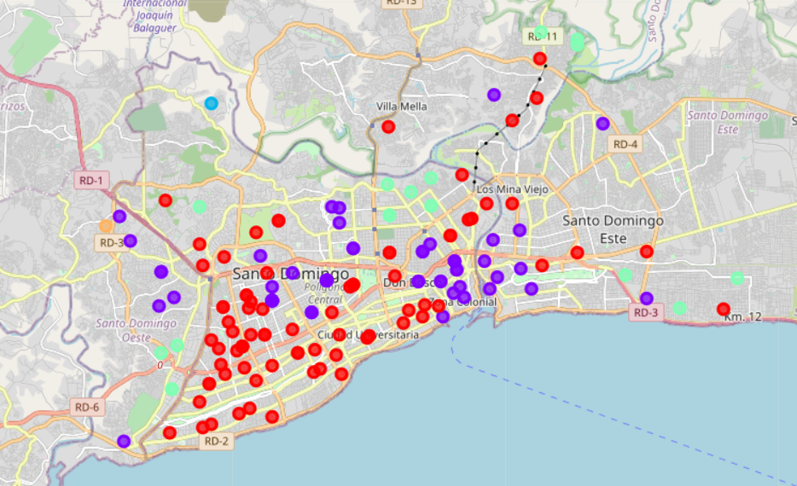
Slide 3
Cluster Neighborhoods
We are going to run K-means to divide the neighborhoods into 5 clusters and create a new data frame that includes the cluster as well as the top 10 venues for each neighborhood.

Slide 16
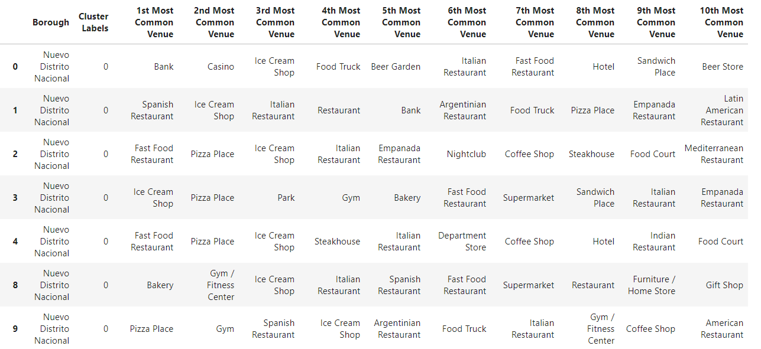
Slide 3
Cluster 1
The venues more characteristic of the first cluster are: Restaurants, Pizza Places, Ice Cream Shops and Supermarkets.

Slide 17
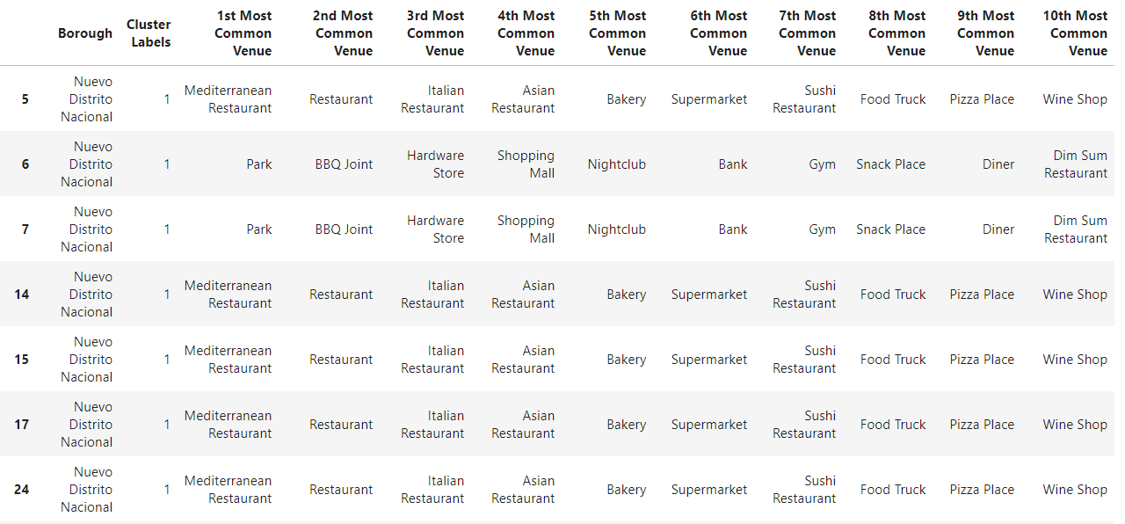
Slide 3
Cluster 2
The venues more characteristic of the second cluster are: Mediterranean Restaurants, Bakeries, Parks, Nightclubs, Gyms and Lounges.

Slide 18
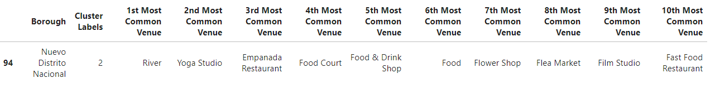
Slide 3
Cluster 3
There in only one neighborhood in the third cluster with the venues of River, Yoga Studio, Empanada Restaurant, Food Court and so on.

Slide 19
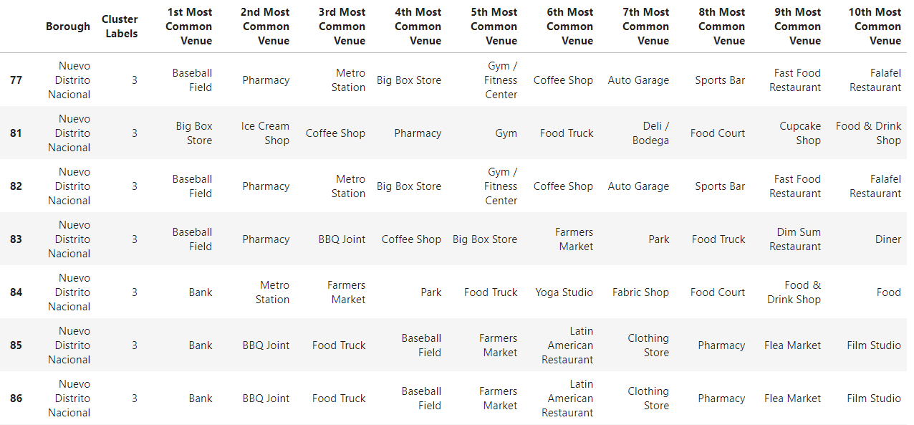
Slide 3
Cluster 4
The venues more characteristic of the fourth cluster are: Baseball fields, Banks and Pharmacies.

Slide 20
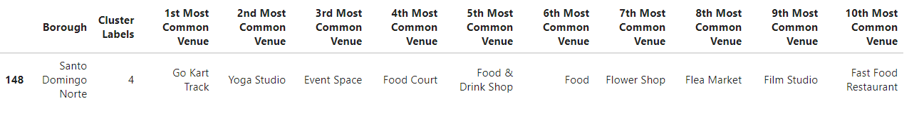
Slide 3
Cluster 5
There in only one neighborhood in the fifth cluster with the venues of Go Cart Track, Yoga Studio, Event Space and so on.

Slide 21
Slide 2
Results
The following were the results obtained in each of the five clusters created:
First Cluster. In the column of first most common venue we see a tendency of business like different types of restaurants (Spanish, Fast Food, Vegetarian and Caribbean), Ice Cream Shops, Pizza places, Metro Stations, Food Trucks, BBQ and Burger Joints. So basically, in this cluster we can see businesses in the food market.
Second Cluster. The businesses most common in this clusters are the ones destined to gather people or to offer a special kind of food like Mediterranean and Chinese restaurants, Bakeries, Bars, Café, Nightclubs, Sports Clubs, Lounges
Third Cluster. This one is contained just by one neighborhood with the most common venue as River.
Fourth Cluster. Health, money transactions and big gathering places are the most common venues in this clusters, like Baseball Fields, Banks and Pharmacies.
Fifth Cluster. This one is contained just by one neighborhood with the most common venue as Go Kart Track.

Slide 22
Slide 2
Discussion
Josh is trying to determine the best place to open a bakery in Santo Domingo and by the K-means clustering, we can determine that the second cluster contains the most common bakery venues. Interestingly, these bakeries are not in the Borough of Nuevo Distrito Nacional (where the most people live and the most developed borough) but in Santo Domingo Oeste (one of the least developed Boroughs in Santo Domingo.
These means that the people who live in the neighborhoods of these borough tend to buy much more in bakeries than in the neighborhoods of different boroughs. If Josh wants to guarantee the success of his business, then the neighborhoods in Santo Domingo Oeste are the ones with the highest possibilities of achieving that.

Slide 23
Slide 2
Conclusion
In this study, I analyzed the most common venues of all the neighborhoods in the city of Santo Domingo, Dominican Republic to determined where is the best place to open a Bakery Store. After adjusting the data, I used the K-means clustering method to divide the city into five different groups and determined which one had bakeries as the most common venues. This model could help anybody to analyze the data of any city or country and determine specific characteristics to be able to answer multiple questions.

Slide 24
Slide 15
THANK YOU!
Junior Peña
junior03b@gmail.com

